Slide 1


A Framework for the Definition and Analysis of Cyber Insurance Requirements
Master Project - Final Presentation
Viktor Matejka, Juan Huacan
Supervisors: Muriel Franco, Eder Scheid
Communication Systems Group CSG Department of Informatics IfI University of Zürich UZH
June 25th, 2021

Slide 2
Table of Contents
Methodology
Interviews with Experts
Refinement of the Framework
Premium Calculation
Case Studies (Application of the Framework)
Conclusions & Future Work

Slide 3
METHODOLOGY

Slide 4
Methodology
BEFORE MID-TERM PRESENTATION
SINCE MID-TERM PRESENTATION
1
2
3
4
5
5
6
LITERATURE REVIEW
MAPPING OF STAKEHOLDERS
DEFINITION OF FRAMEWORK
INTERVIEW WITH EXPERTS
REFINEMENT OF FRAMEWORK
PREMIUM CALCULATION
EVALUATION
100+ papers scanned. 34 analysed. 9 key selected. Conducted concept mapping.
Identify all relevant and key stakeholders and their interactions.
Define a cyber insurance framework based on the literature review
Conduct interviews with experts in the cyber insurance field to validate our framework
Apply suggestions and feedback to our framework. The outcome is the final refine framework
Review different premium calculations methods based on current industry practices
Evaluate the premium calculation based on a case study

Slide 5
Literature Review
Analysis
The selected papers were studied to extract all the information about the current frameworks that exist already in the market. Our proposed framework was created from this source of information.
1
3
Paper selection
According to our project’s interests, approx. 34 papers were selected as part of our related work.
2
2
Search
Over 136 papers were found following different searching techniques. They are considered our source of information through all the present project.
1
3

Slide 6
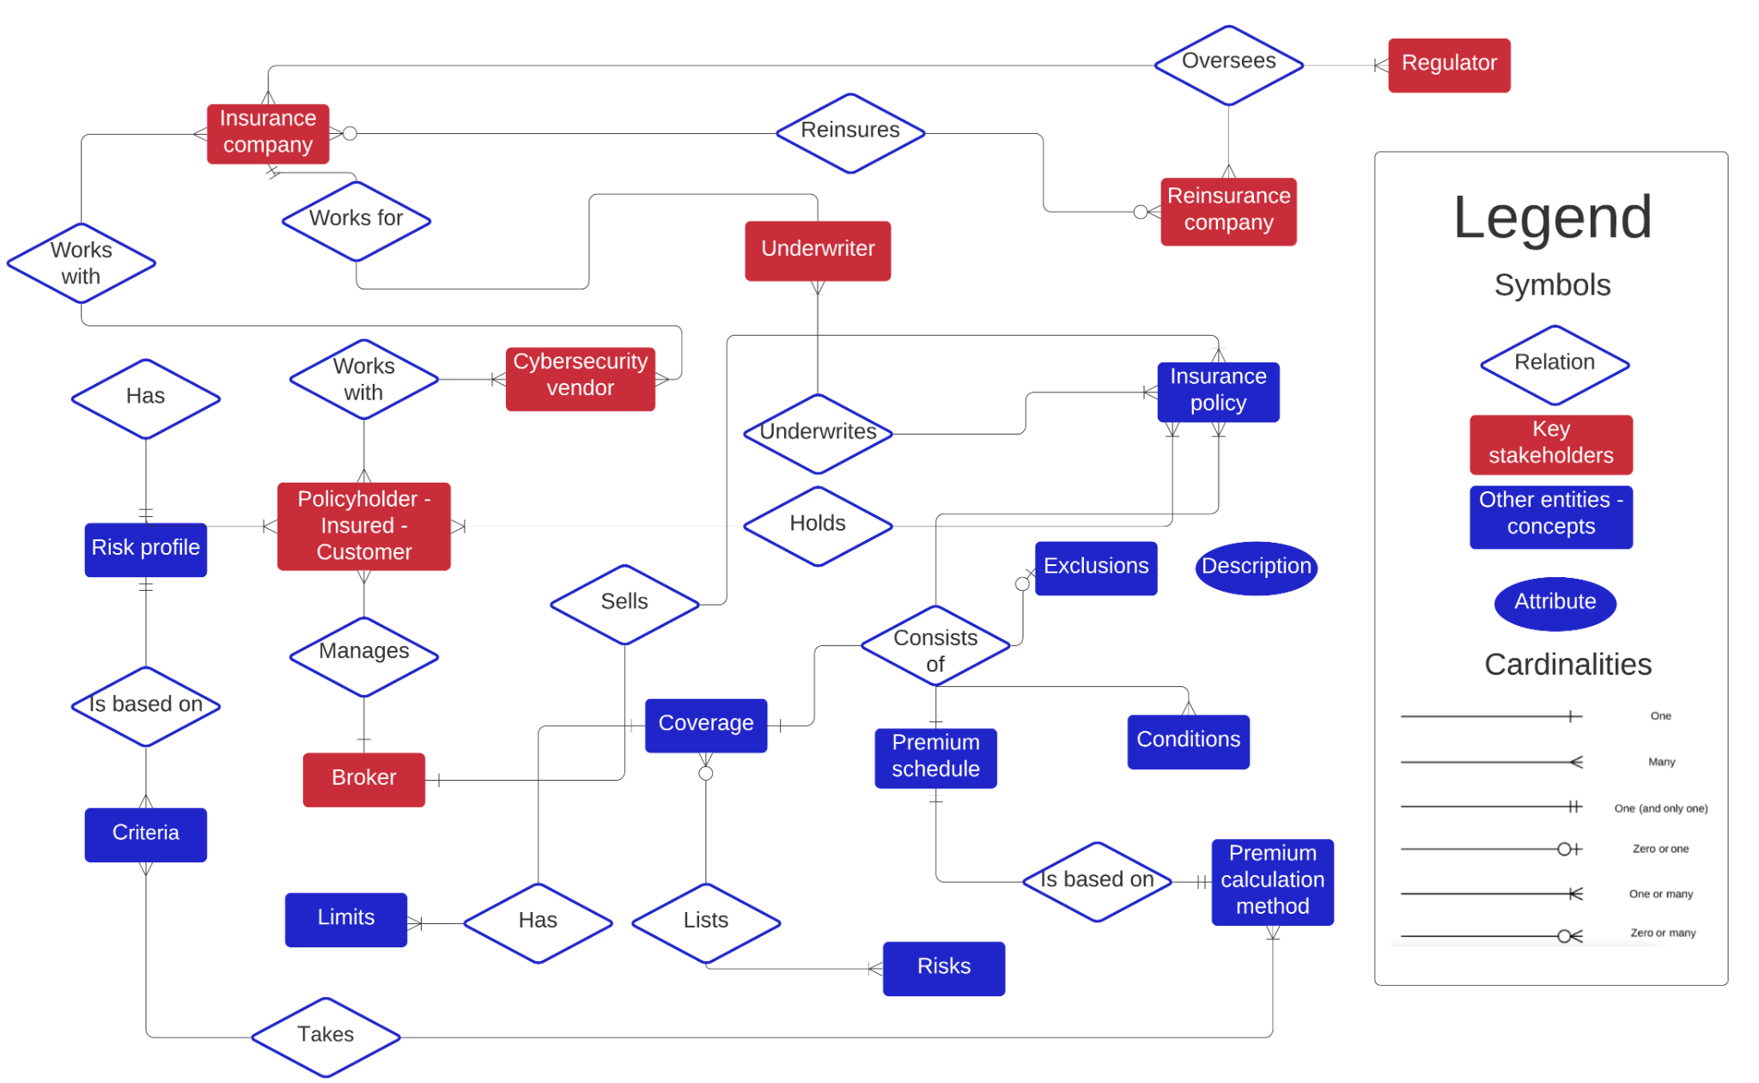
Mapping of Stakeholders

Slide 7
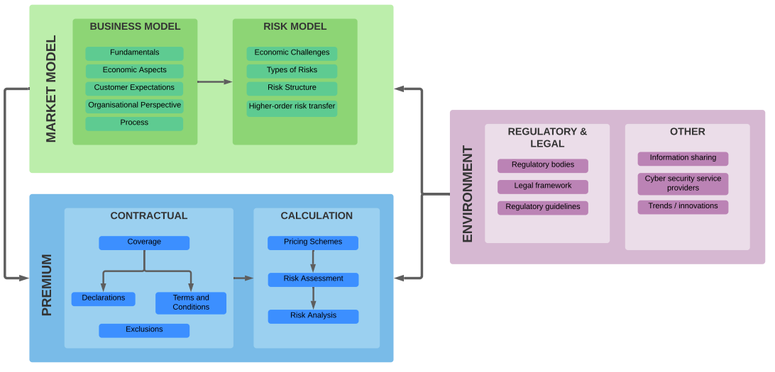
Definition of the Framework

Slide 8
INTERVIEWS WITH EXPERTS

Slide 9



Interviews & Survey - the setup
Contact 15 senior cyber insurance experts through Linkedin.
3 of them agreed to have an interview
Demographics
Number of interviewees : 3 experts
Experience : 7-15 years
Role : Underwriters & Cyber risk Analysts
Anonymous Global Insurance Company

Slide 10
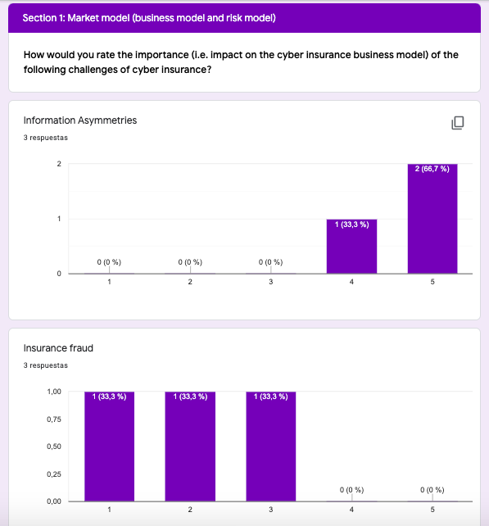

Structure of interview
Semi-structured interview
Survey
General Information
Framework

Slide 11
Interviews with experts - Takeaways
Framework Pillar | General Information
Market Model | Challenges of cyber insurance | Interdependent security/Systemic risks Reputational risks Limited actuarial data
Premium and Contract Design | Methods used for underwriting process | Questionnaires Security audits Partnerships with cyber-security vendors
 | Most relevant steps of cyber insurance process | Claim handling Individual risk estimation
Environment | Regulation | Cyber insurance well regulated

Slide 12
Interviews with experts - Takeaways
Framework Pillar | Feedback
Market Model | Suitable for users that begin in this field, it is complete (e.g. start-ups). Too broad for seasoned insurers already in the business. Emphasize the importance for companies to do both: reinforce security standards and get cyber insurance. Importance of cyber reinsurance confirmed
Premium calculation | Unanimous agreement of completeness and understandability of this pillar. IMPORTANT: Confirmation of base rate with modifications
Environment | Emphasize the presence of “external malicious attacks”

Slide 13
REFINEMENT OF THE FRAMEWORK

Slide 14
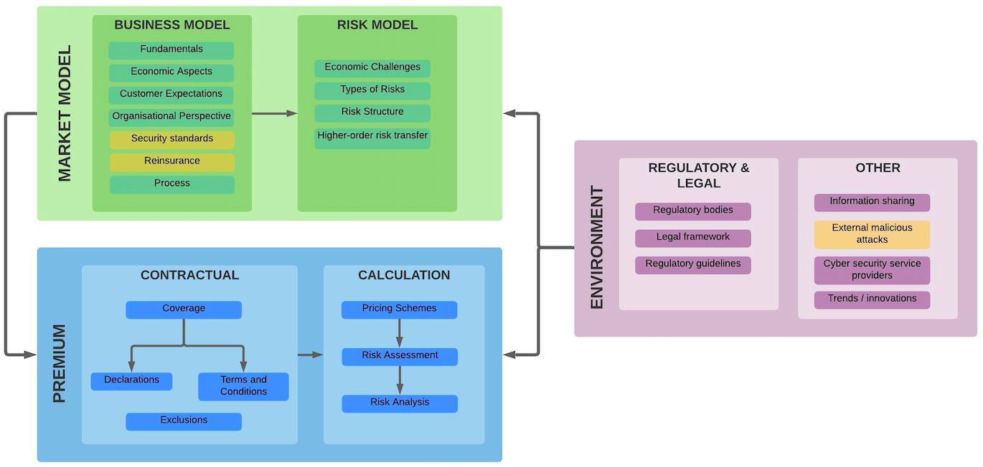
Refinement of the framework

Slide 15
PREMIUM CALCULATION

Slide 16
Premium Calculation
Literature review
Empirical analysis: Challenges and approach to analysis
Outcomes
What can be generalised about premium calculation?
Typical premium calculation process
What can not?
Heterogeneity in policies, risk segmentation, assumptions

Slide 17
Literature review: Key papers on modelling and pricing
Paper | Title | Risk Modelling | Premium Calculation | Data Sources
Böhme et al. (2019) | A Fundamental Approach to Cyber Risk Analysis | YES | NO | YES
Bardopoulos (2020) | CYBER-INSURANCE PRICING MODELS | YES | NO (focus on model) | YES
Romanovsky et al. (2019) | Content analysis of cyber insurance policies: how do carriers price cyber risk | NO | YES (review of policies) | partially
Xu & Hua (2017) | Cybersecurity Insurance: Modeling and Pricing | YES | YES | NO
Master Project Cyber Insurance Framework |  | in reference | YES (practical focus) | YES

Slide 18
Challenges - Premium calculation
Proprietary data
Intransparency and gap between documented process and practice
Underwriters apply discretion and “gut-feelings” when determining actual premiums in many cases
Number of modelling approaches (at least 23 different)

Slide 19
Solution - Empirical analysis
Clearly define scope and focus on production approaches of market leading companies (rather than proposals)
Choose SERFF (mandatory policy database in the U.S.) by NAIC as chief data source
Select a sample:
8 underwriting manuals, 34 contracts for analysis of coverage and exclusions (following methodology of Romanovsky et al.)
Analyse, reimplement (tabular calculations) and test
Compare
Extract a generalisable premium calculation process
Apply to case studies

Slide 20








What can be generalised about premium calculation?
Company | Chubb | Travelers | NYMAGIC | Zurich | Amerirust | Hiscox | BCS | HSB
Base rate | YES | YES | YES | YES | YES | YES | YES | YES
Base rate metric | Prospective fiscal year revenue | Total Assets Under Management | Limit/deductible combination | Annualized projected revenue | Revenue | Revenue (marginal calculation) | Total Interest Income x Rateable Revenue Factor | Combination of Annual Revenue and Net Operating Expenses
Industry segmentation | NO | YES | YES - for eligibility | YES | NO | YES | YES | YES
Other risk segmentation | Hazard groups | Business Classes | Tiers | Tiers | NO | Hazard Groups | Groups | Occupancy tiers
Information security pricing | YES | YES | NO | NO | NO | YES | YES | YES

Slide 21
Underwriting manuals/guidelines (regulatory filings) used for the premium calculation chapter
Company | SERFF Number | Reference used in this report
Chubb | XX | UM1
Travelers | XX | UM2
NYMAGIC | XXXX | UM3
ZURICH | XX | UM4
AmeriTrust | XX | UM5
HISCOX | XSX | UM6
BCS | XX | UM7
HSB by Munich Re | XX | UM8

Slide 22
What can not be generalised about premium calculation?
Contracts highly heterogeneous
Different terminology and coverage definitions
Some differences in exclusions
Different risk segmenting
Geographic differences

Slide 23
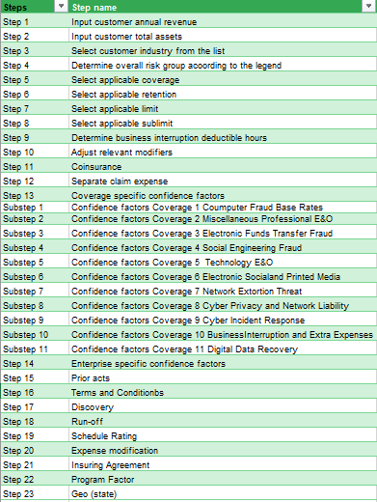
Formula/process heterogeneity across different policies
Example
Example
Steps | Step name
Step 1 | Determine Tier
Step 2 | Determine Revenue
Step 3 | Select Base Rate (using Linear Interpolation)
Step 4 | (OPTIONAL) Apply Increased Limit Factor based on Tier
Step 5 | (OPTIONAL) Sublimit Adjustment Factor
Step 6 | (OPTIONAL) Qualifying Period Factor
Step 7 | (OPTIONAL) Protection Period Factor
23 vs. 7 steps foreseen

Slide 24
CASE STUDY (APPLICATION OF FRAMEWORK)

Slide 25
Case Study: eCommerce
Set-up: Insurance company wants to enter the cyber insurance market by offering coverage to mid sized to eCommerce companies interested in purchasing business interruption policy (e.g. due to DDoS, Privacy Breach, Security Breach, Administrative Error ...)
Case study goals:
Holistic application of the framework
Demonstration of typical premium calculation
Pricing in absolute terms not in focus
Case summary: Key inputs
Modelled after an actual European eCommerce company
Revenue: 43 000 000,00 CHF
Asset size: 314 000 000,00 CHF
Industry: Home & Furniture Retail / eCommerce with some physical locations

Slide 26
Case Study: Market Model Pillar
Customer expectations: Streamlined process (small ticket comparatively)
Selected Key Coverage: Business Interruption (first-party) - however, most steps (and some modifiers) analogous for other types of coverage
Underwriting process: Questionnaire / underwriting meeting (broker)
Reinsurance: Some type non-proportional reinsurance treaty agreement (or reinsurance pool) to cover for possible aggregation
Notes:
Critical question: What is covered when ransomware attack causes a blackout?
Answer: Cyber and privacy insurance policies termed "cyber-extortion coverage". typically cover (1) monies to pay ransom demands, (2) experts to negotiate with hackers, and (3) the cost of computer forensics expert.
Excess of loss reinsurance can have three forms - "Per Risk XL" (Working XL), "Per Occurrence or Per Event XL" (Catastrophe or Cat XL), and "Aggregate XL".
In per risk, the cedant's insurance policy limits are greater than the reinsurance retention. For example, an insurance company might insure commercial property risks with policy limits up to $10 million, and then buy per risk reinsurance of $5 million in excess of $5 million. In this case a loss of $6 million on that policy will result in the recovery of $1 million from the reinsurer. These contracts usually contain event limits to prevent their misuse as a substitute for Catastrophe XLs.
In catastrophe excess of loss, the cedant's retention is usually a multiple of the underlying policy limits, and the reinsurance contract usually contains a two risk warranty (i.e. they are designed to protect the cedant against catastrophic events that involve more than one policy, usually very many policies). For example, an insurance company issues homeowners' policies with limits of up to $500,000 and then buys catastrophe reinsurance of $22,000,000 in excess of $3,000,000. In that case, the insurance company would only recover from reinsurers in the event of multiple policy losses in one event (e.g., hurricane, earthquake, flood).
Aggregate XL affords a frequency protection to the reinsured. For instance if the company retains $1 million net any one vessel, $5 million annual aggregate limit in excess of $5m annual aggregate deductible, the cover would equate to 5 total losses (or more partial losses) in excess of 5 total losses (or more partial losses). Aggregate covers can also be linked to the cedant's gross premium income during a 12-month period, with limit and deductible expressed as percentages and amounts. Such covers are then known as "stop loss" contracts.

Slide 27
Case Study: Premium Pillar
Overall setup
Pricing scheme: Base rate with modifications
Risk assessment - 2 options for the case
either broker model (supports risk assessment) with underwriter approval
or automated underwriting engine based on self-assessment (legally binding), possibly with underwriter approval/manual adjustments
Risk analysis - actuarial data / modifier value source used in the case study: Chubb Reinsurance (SERFF database)

Slide 28
Case Study: Premium Pillar
Premium Calculation
Steps | Step name | Result | Comments | Framework mapping
Step 1 | Input customer annual revenue | 47 000 000,00 CHF |  | Risk assessment
Step 2 | Determine overall risk group (0-6) | 2 | Material amounts of new records and generally store Material amounts of historical Moderately-critical products | Risk modelling and risk assessment
Step 3 | Select applicable coverage | Business Interruption | Malicious cyber act causes cyber damage | Contractual - coverage
Step 4 | Select applicable base rate | CHF 3974 | Linear interpolation on actuarial tables | Risk modelling
Step 5 | Select applicable retention | CHF 10k retention | 0.975 | Contractual - coverage
Step 6 | Select applicable limits and sublimits | CHF 1M per occurrence / aggregate |  | Contractual - coverage
Step 7 | Determine business interruption deductible hours | 5 | 1.20 factor | Contractual - coverage
Step 8 | Adjust relevant limit modifiers | 750k | 0.875 factor, revenue in a typical week | Contractual - coverage
Step 9 | Coverage specific confidence factors | 1 | overall Alpha (C) assumed 1 | Risk assessment
Step 10 | Enterprise specific confidence factors | 1 | overall Alpha (E) assumed 1 | Risk assessment
Step 11 | Annual premium (business interruption) | CHF 4068 | analogous process would be applied to other coverage elements | Premium calculation

Slide 29
Case Study: Premium Pillar
Risk analysis & Segmenting risks
Company | Base rate metric | Risk Group | Industry Classification | Alpha (overall) | Default Limit | Retention
Chubb | Prospective fiscal year revenue | Hazard group 3 | N/A | 1 | 1000000 | 10000
Travelers | Annual Revenue | N/A | PUBLIC, PRIVATE and NON-PROFIT | 1 | 1000000 | 25000
NY Marine and General Insurance (HSB policy) | Flat by Tier, Limit and Deductible combination | Tier 2 | N/A | 1 | 1000000 | 10000
Zurich NA | Annualized projected revenue | Tier 2 | 57 Home Furniture, Furnishings and Equipment Stores | 1 | 1000000 | 25000
AmeriTrust ( Lloyd’s) | Annual Revenue | No risk groups (small business policy) | No risk groups (small business policy) | 1 | 1000000 | ?
Hiscox Insurance | Revenue (marginal calculation) | N/A | ALL COMPANIES | 1 | 1000000 | 10000
BCS | Total sales x Rateable Revenue Factor | Group 3 | eCommerce - Industry group 3 | 1 | 1000000 | based on revenue
HSB | Combination of Annual Revenue and Net Operating Expenses | Occupancy Tier 2 | N/A | 1 | 1000000 | 10000
SKIPPED - POSSIBLY FOR DISCUSSION

Slide 30
Case Study: Premium Pillar
Risk assessment: Information Security pricing example
Coverage specific
Enterprise specific
Business Interruption | Range (Low) | Range (High)
Critical Application Assessments | 0,75 | 1,25
Criticality of Network to Applicant | 0,75 | 1,25
Dependency on real time transactions | 0,75 | 1,25
Loss History | 0,75 | 1,25
Mirror/Backup Procedures | 0,75 | 1,25
Network Technology | 0,75 | 1,25
Risk Management for IR Planning | 0,75 | 1,25
Technology Risk Management Process | 0,75 | 1,25
Volatility/Recovery in Sales | 0,75 | 1,25
Modifier Description | Range (Low) | Range (High)
Centralized Policies & Procedures | 0,75 | 1,25
Financial Condition | 0,75 | 1,25
Nature of Operations | 0,75 | 1,25
Network Security | 0,75 | 1,25
Physical Security | 0,75 | 1,25
Quality of Service Provider Contracts | 0,75 | 1,25
Quality of Service Providers | 0,75 | 1,25
Risk Management Controls | 0,75 | 1,25

Slide 31
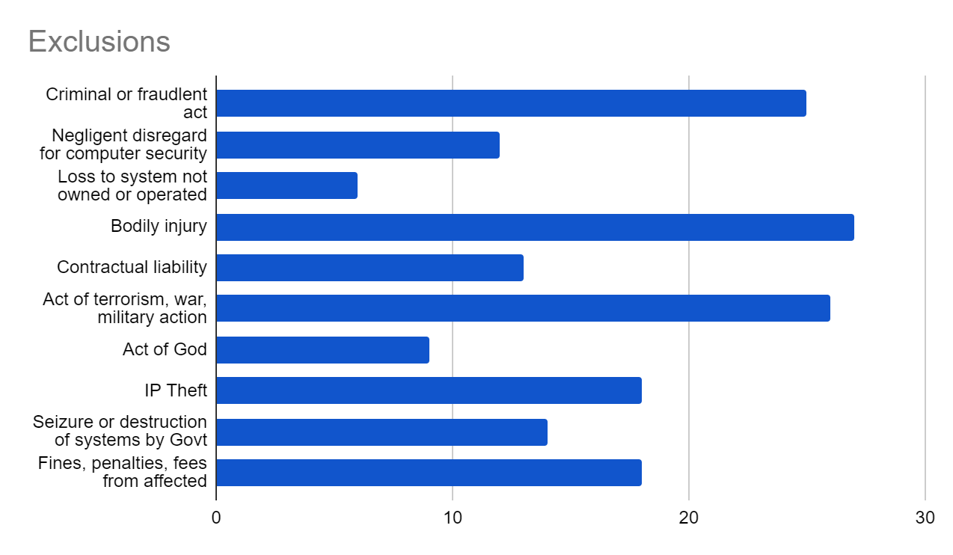
Case Study: Premium Pillar
Contractual: Typical exclusions
We analysed 34 policies (source: SERFF) and matched exclusions to common categories proposed by Romanovsky et al. to estimate the “typical ones” expected in a generalised contract

Slide 32
Environment: Data sharing How do insurers cope with information asymmetries?
Risk Analysis Tool | Link | Source | Value Proposition (according to vendor’s website)
Verisk Air Cyber Solutions | https://www.air-worldwide.com/ | Interviewee 1 | cyber risk modeling and analytics platform
Cysmo business suite | https://www.cysmo.de/en/index.html | Interviewee 1 | automated rating of a company's IT
Advisen specialty risk data | https://www.advisenltd.com/ | Interviewee 1 | specialty risk data
RMS Cyber Solutions | https://www.rms.com/ | Interviewee 1 | cyber risk analytics and cyber risk data
Bitsight | https://www.bitsight.com/ | Interviewee 3 | Security Rating independently correlated with breach risk and stock performance
Insight from interviews and empirical analysis: quantitative/alternative data either not used at all, or as a “second opinion” provided by a vendor (such as BitSight) and regarded typically as experimental and unreliable to determine actual premiums

Slide 33
CONCLUSIONS & FUTURE WORK

Slide 34
Conclusions
Project Goals | Conclusions
Survey on cyber insurance frameworks and models.
Define requirements, steps, metrics, and actors.
A structured research methodology was key to define the different processes, steps and stakeholders involved in the Cyber Insurance context (Process mapping, ER Model).
Definition and design of a cyber insurance framework.
A cyber insurance framework is definitely useful for new market entrants, less so for market leaders (broad approach)
Review of actuarial models and approaches to calculate a fair premium for a given contract
Base rates with modifications are the go-to-method to determine premiums.
Premiums are getting more expensive (more than 60% this year already).
We confirmed via case studies that a structured approach can help defining a cyber insurance product
Evaluation through case studies.
Research Contribution
Key: Up-to-date requirements engineering approach to cyber insurance

Slide 35
Future Research (Thesis concept):
Process Mining for CI Underwriting
The Problem | The Prospective Solution Approach
Information asymmetries identified as key problem, underwriting meeting often focuses on processes | Test a way to reduce the fundamental problem of information asymmetries - whether underwriter discretion could be complemented by process mining analysis (process conformance checking, process discovery)
Not one underwriter mentioned that new risk models are needed -> rather ways to understand individual risk | Increase the risk mitigation effect (apart from risk transfer)
Industry relies on intuitions and “underwriting meetings” | Explore alternative to historical actuarial data
First applications of process mining in cyber security proven, but none applied to CI underwriting | Apply process mining to a new domain that might be synergistic with other application of process mining

Slide 36
Future Research: additional direction
Some industry actors are pushing for more standardisation in insurance associations such as PEIF (data sharing, questionnaire standardisation etc).
Claims process in clear focus
Some insurance companies are exploring alternative models analogous to telematics in car insurance - CyberMatics by AIG (launched in late 2020) - with the goal to play a risk mitigation role, in addition to risk transfer

Slide 37
Q&A

Slide 38
THANK YOU!

